Slide 1
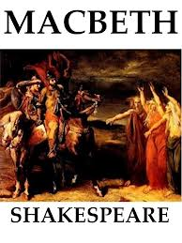
Dr. Jyothy C.R

Slide 2
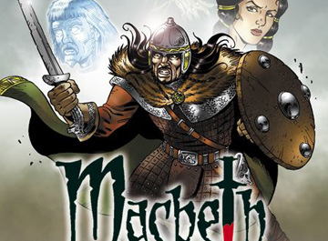
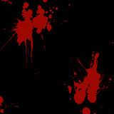
The Tragedy of Macbeth
Set in Scotland
Written for King James I (formerly of Scotland, now England)
Shakespeare researched The Chronicles by Raphael Holinshed. Many of the characters are real ancestors of King James I

Slide 3
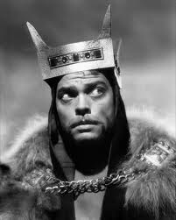
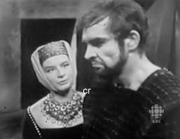
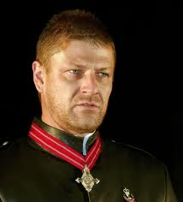
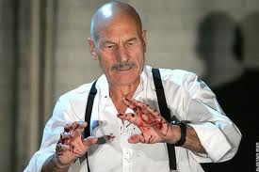
Macbeth Introduction
Written by William Shakespeare in 1605
Macbeth is a man who overthrows the rightful King of Scotland
Shakespeare wrote Macbeth at the beginning of King James I reign
Before James succeeded Elizabeth I he was king of Scotland

Slide 4
Will the real Macbeth please stand up?
Macbeth was a real king of Scotland
He did kill King Duncan
Reigned from 1040-1057
Unlike the Macbeth in Shakespeare’s play
The real Macbeth had a legitimate claim to the throne
The real Macbeth was a strong leader
The real Macbeth’s reign was successful
The real Macbeth was killed at Lumphanan as opposed to Dunsinane

Slide 5
ANALYSIS
Macbeth is an anomaly among Shakespeare's tragedies in certain critical ways. It is short: more than a thousand lines shorter thanOthello and King Lear, and only slightly more than half as long as Hamlet. This brevity has suggested to many critics that the received version is based on a heavily cut source, perhaps a prompt-book for a particular performance..

Slide 6
Connections for British Society
“Remember, remember the fifth of November Gunpowder, treason and plot. I see no reason why gunpowder, treason Should ever be forgot...”
In November 1605 the Gunpowder Plot was discovered
Guy Fawkes and his followers (Roman Catholics) planned to blow up Parliament
They wanted to bring down the British government and put a Catholic rulers on the throne
The plot was discovered and the men involved were tried and killed as traitors
Shakespeare sided with the king and seemed to think that a play about treason and death would find an audience at this time

Slide 7
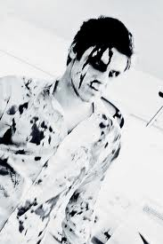
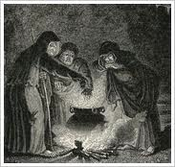
So this is a comedy… right?
Macbeth is one of Shakespeare’s most famous tragedies (it is also his shortest)
Aside from the violent nature of the plot Shakespeare uses several literary devices to enhance the feeling of evil
He creates a serious and sinister mood by having most of the play take place at night
There is a heavy emphasis on the supernatural (witches, dreams, spells, and ghosts)

Slide 8
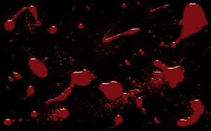
Characters
King Duncan of Scotland
Murdered by Macbeth
Honest and good
Malcolm & Donalbain
Sons of the King
Malcolm is the eldest son
Macbeth
Duncan’s most courageous general and a great warrior
Already the Thane of Glamis (becomes Thane of Cawdor and then king)
Ambition to become king corrupts him causing him to murder Duncan

Slide 9
Banquo
General and Macbeth’s best friend
Suspects Macbeth in connection to Duncan’s murder
An actual ancestor of King James I
Lady Macbeth
As ambitious as her husband
A dark force behind his evil deeds
Macduff
Scottish general, suspects Macbeth of murdering the king
Macbeth has his family murdered
Swears vengeance

Slide 10
The Scottish Play
It is believed to be bad luck to speak the word ‘Macbeth’ in a theatre
Legend has it you will lose all your friends involved in the production—horribly
The legend says that an early actor to play Macbeth died when a real knife was used instead of a stage knife
Other strange occurrences and mishaps surround the play

Slide 11
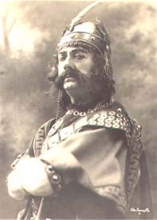
Tragic Hero
“Man of high standard who falls from that high because of a flaw that has affected many” - Aristotle
Macbeth is one of the most famous examples of the tragic hero.
Just as other tragic heroes, Macbeth has a “fatal flaw”.
In Macbeth’s case, it is ambition and obsession

Slide 12
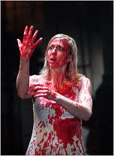
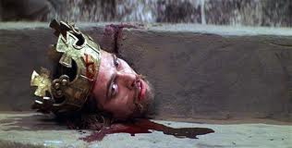
So what really happens?
Good guy goes bad
Good guy wants power
Married to an evil, ambitious woman
She wants power
Kills people- LOTS of people
Gets power
Gets paranoid (a.k.a. goes crazy)
Ticks off a lot of people
Want more power! Kill! Kill!
Gets what’s coming to him in the end

Slide 13
Themes
Ambition and the pursuit of power causes downfall
Cruelty vs. Manhood (Do you need to be a man to be cruel?)
King vs. Tyrant (What’s the difference?)
Symbols
The supernatural (ghosts, witches)
BLOOD
Weather (Hurly-burly)

Slide 14
FAMOUS LINES "Look like the innocent flower, but be the serpent under 't." Macbeth Quote (Act I, Scene V). "Is this a dagger which I see before me, The handle toward my hand?" Macbeth Quote (Act II, Scene I). "Out, out, brief candle! Life's but a walking shadow, a poor player that struts and frets his hour upon the stage and then is heard no more: it is a tale told by an idiot, full of sound and fury, signifying nothing." Macbeth Quote (Act V, Scene V).

Slide 15
THANK YOU
JYOTHY C R

